Slide 1





01 February 2026
10:00 AM – 02:00 PM CST
Coworking space
Barcelona, Spain
agentcamp.city/{citname}
Sponsored by:
Notes:
[Customize with your event details]

Slide 2



Build & launch AI agents fast Microsoft Foundry and the AI Toolkit
01 February 2026
10:00 AM – 02:00 PM CST
Coworking space, Barcelona, Spain
Tanya Smith
Sr. Software Engineer
Sponsored by:
Notes:
[Customize with your event details]

Slide 3


Customer scenario
Bruno Zhao
Customer
“I know how I want the room to feel. I just don’t know what products will get me there.”
Notes:
It’s Saturday morning. Bruno Zhao stands in his apartment living room—coffee in one hand, his phone in the other—snapping a photo of the space he’s about to transform.
He’s finally ready to paint. He knows the vibe he’s going for: warm, cozy, maybe something with a little depth. But now he’s staring at a bigger question: Eggshell or matte? Satin or semi-gloss?
He wants the walls to feel elegant but still hide imperfections. He’s not a pro—and one wrong decision could mean repainting everything next weekend.
Zava, his local home-DIY store, carries all the essentials. But finding the right finish? That’s where things get tricky.
And that’s exactly where our story—and our app—begins.

Slide 4

Developer response
“Let the model do the reasoning—so the customer doesn’t have to.”
Serena
App Developer, Zava
Notes:
Now meet Serena. Serena’s a developer at Zava. Her job?
To help customers like Bruno get the right recommendations—without needing to search for hours or stand in line at the paint counter.
But she’s got a constraint: limited time, a huge product catalog, and a business that needs results fast.

Slide 5
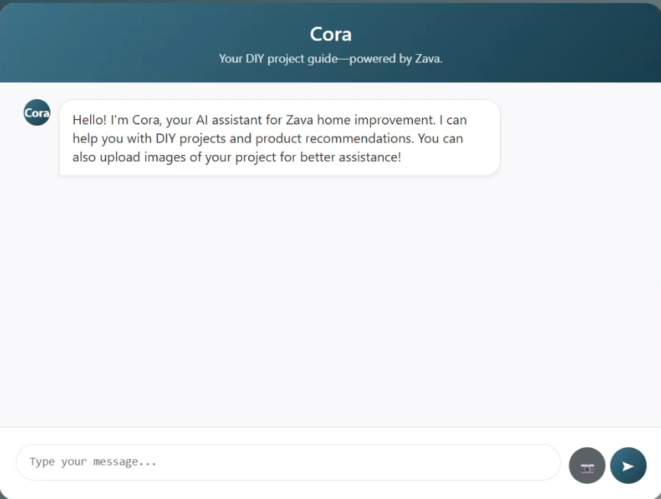
Meet Cora
An intelligent customer-facing AI agent, powered by a multimodal model and live access to Zava’s product data
Notes:
So, she builds Cora—a multi-modal AI agent created and scaled with Microsoft Foundry. Cora isn’t just chatty. Cora takes Bruno's input about his project and searches through Zava's catalog to find exactly what Bruno needs. Bruno can submit photos to Cora and Cora can process those photos as context when generating its product recommendations.

Slide 6
Agenda
GenAI ops
Meet the models
Design your agent
Evaluate your agent responses
From prototype to production
Notes:
And today, I’m going to show you how Serena did it all within Visual Studio Code!
In this session, we’re going to explore developer-grade agent building—from first prototype to production.
You’ll see how Serena:
- Rapidly tested and compared Foundry models
- Streamlined prompt engineering and the agent developer workflow w/ the Agent Builder in the AI Toolkit
- Evaluated agent responses using both manual testing and AI-assisted evaluators directly within the AI Toolkit
- Finally, we’ll talk about what it takes to move from a working prototype to something production-ready.
Serena didn’t just stop after the agent was responding correctly—she thought about how to monitor, scale, and ship it responsibly.
You’ll see how Serena bridged the gap to production using Microsoft Foundry resources.
Serena’s story isn’t just about building—it’s about shipping smarter, with the right tools at every step. That’s what today’s session is all about.

Slide 7

The way we build apps has evolved
Modern apps
Intelligent apps
Deterministic
Writing Code
Building Features
Testing
Probabilistic
Writing Prompts
Creating Agents
Evaluation
Notes:
But let’s zoom out for a second.
Because Serena’s not alone. Developers everywhere are building AI-powered apps right now—from side projects to full-on production systems.
And what we’re seeing is this:
The tooling for GenAI has exploded. There are more models, APIs, vector databases, and orchestration frameworks than ever before. Which is exciting… but also overwhelming.
Because here’s the reality:
Building an AI prototype is easy.
Getting that prototype into production—that’s the hard part.
You’ve got to pick the right model. Tune prompts. Add evaluations. Hook into your backend. Handle state, latency, cost. And don’t forget governance, security, responsible AI.

Slide 8
Generative AI development lifecycle
Managing
PREPARE FOR APP DEPLOYMENT
ADVANCE PROJECT
Find LLMs
Retrieval Augmented Generation
Quota and cost management
Hypothesis
BUSINESS NEED
Monitoring
Deploy LLM App/UI
Design
Exception Handling
Customize
Manage
Evaluation
Protect & govern
Content Filtering
REVERT PROJECT
SEND FEEDBACK
Notes:
That’s where the idea of GenAI Ops comes in.
Just like DevOps brought structure to traditional software development, GenAI Ops is about bringing workflows, tools, and repeatability to how we build, test, and ship AI experiences.
In this session, you’ll see what GenAI Ops looks like in practice—using tools available in Microsoft Foundry, and the AI Toolkit in VS Code.
You’ll follow Serena’s journey not just to build an agent but to ship one that’s useful, trusted, and scalable.
Let’s dive in!

Slide 9
Meet the models
Notes:
The first real decision Serena faced wasn’t tools or deployment—it was picking the right model to power Cora.

Slide 10
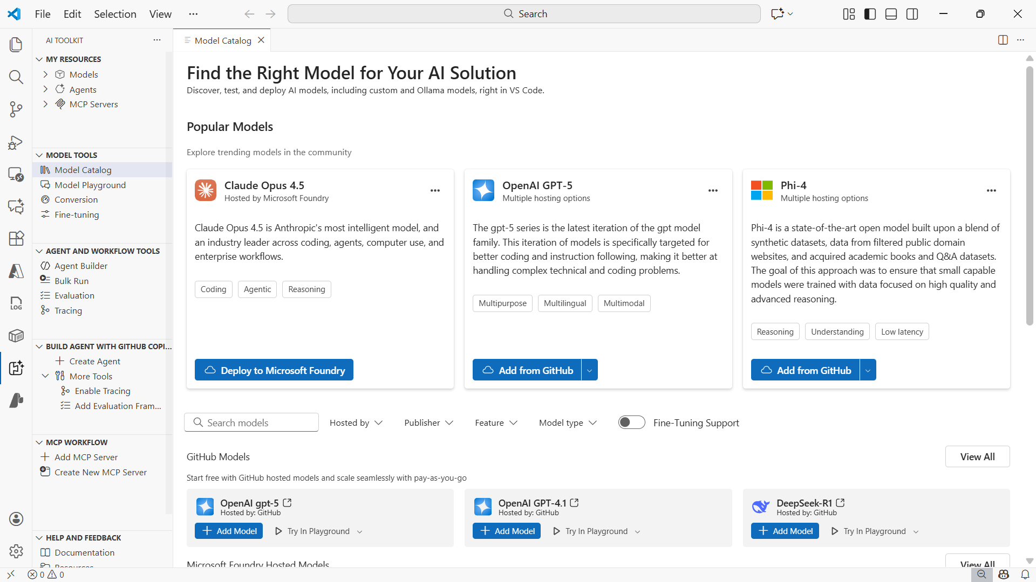
AI Toolkit Extension
AI development natively embedded in your VS Code workflow
Notes:
And this is where the AI Toolkit for Visual Studio Code comes in.
The AI Toolkit is a full development environment right inside VS Code that gives you everything you need to explore models, build agents, evaluate responses, and deploy to Azure.
It’s built for developers who want to go beyond quick experiments and actually build, test, and ship AI-powered apps.
And at the core of that experience is the Model Catalog—your starting point for choosing and experimenting with models.
You can use:
GitHub-hosted models — free to use, no API key needed, and ideal for prototyping or trying out agent logic. Although they’re rate-limited, you do have the option to leverage GitHub’s pay-as-you-go model.
Azure-hosted models — for enterprise-grade apps where performance, scale, and compliance matter.
Third-party APIs — like OpenAI, Mistral, Cohere, or anything you can hit with a REST endpoint.
And even local models — including those running through Foundry Local, Ollama or your own custom setup.

Slide 11
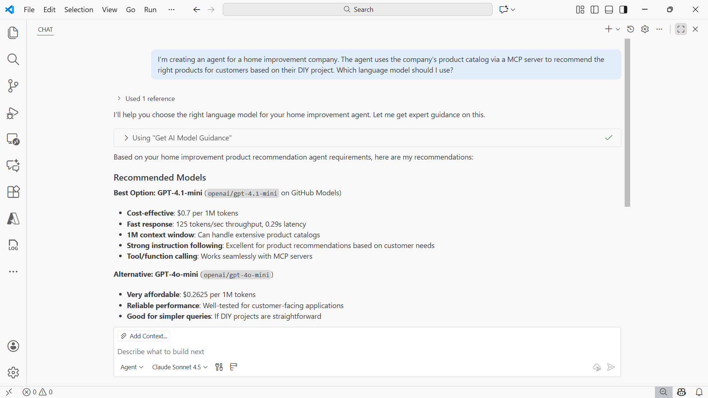
GitHub Copilot Agent Mode
Develop alongside an AI agent that can transform ideas into production-ready agents within minutes
Notes:
And if you aren’t sure about which model to choose, then GitHub Copilot is here to help! GitHub Copilot Agent Mode is like having an autonomous peer programmer right inside your editor.
In fact, GitHub Copilot Agent Mode can help with the complete agent building experience. The AI Toolkit embeds agent development workflows directly into Visual Studio Code and GitHub Copilot, enabling you to transform ideas into production-ready agents within minutes. Equipped with several AI Toolkit tools, GitHub Copilot Agent Mode can recommend models, build and orchestrate agents using the Microsoft Agent Framework, trace agent behavior, and evaluate agent responses for quality.
As for Serena, her first step was to ask GitHub Copilot for a model recommendation.
Let’s look at how she did that.

Slide 12
Demo: Explore and compare models
Notes:
00:00:00:10 - 00:00:22:15
So here within Visual Studio Code, I'm going to open up GitHub Copilot chat. Once this is open I can expand this. So that way I can see a bit more on the screen. Now, right now what we're going to need is a recommendation of model or models to help run the Cora agent. And so I'm passing in a prompt that says I'm creating an agent for a home improvement company.
00:00:22:17 - 00:00:47:07
The agent uses a company's product catalog via a MCP server to recommend the right products for customers based on their DIY project. Which language model should I use? Now that that's been sent, what's going to happen is that GitHub Copilot is going to leverage one of the AI toolkit tools that it has access to. And in this case, it's using the get AI model guidance tool.
00:00:47:09 - 00:01:12:01
This particular tool is going to assist GitHub Copilot with understanding the best practices around model recommendation. And we do seem to have an answer here. So if I scroll up I can see that the overall choice in model is GPT 4.1 mini. It takes things into consideration, such as the quality score. So that's taking things like benchmarks into account.
00:01:12:03 - 00:01:35:22
Then there's costs. And this is going to be very helpful because Zava would like to have a better understanding of how much these models are going to cost when they're being used in production, or at least to have an estimate of what their total cost will be as customers are using the Cora agent. We also have additional information here with respect to latency.
00:01:36:02 - 00:02:05:14
We really want to ensure that the Cora agent doesn't necessarily take too long to provide a response to customers. And then we also have information here about the context window. There's information here about coding. That's not as necessary for this agent, but it does call out that it does excel in instruction following. Just below that, GitHub copilot recommended a budget friendly alternative, which is going to be GPT 4.1 nano.
00:02:05:16 - 00:02:32:09
And also it does note here that if we just want to get started with trying something free, we could try the GPT 4.1 mini model using one of the GitHub hosted models. And so from here, the next thing that we would need to do is actually go test out this model and let's assess how well it performs against our given scenario.
00:02:32:11 - 00:02:37:16
So to do that we're going to open up the model catalog in the AI toolkit.
00:02:37:18 - 00:03:02:23
Within the model catalog. We're able to see a variety of models that are going to be available for use. And as we scroll down we can apply different filters such as who's the model hosted by the model publisher. Features as well. So knowing that we want to use a model that supports image attachments, that will be a really good feature to apply here.
00:03:03:01 - 00:03:21:05
And we can also look at model types. And then also if we need fine tuning support, I already know that I want to give the GPT 4.1 mini model a try, and so I can search for that one directly.
00:03:21:07 - 00:03:31:12
And here I see that we have a couple of options available. There's one from GitHub. There's one from Microsoft Foundry as well. And then there's also one from open AI.
00:03:31:14 - 00:03:43:00
Since Zava would like to develop agents for Microsoft Foundry, we're going to use a Microsoft Foundry model. So from here what we would do is deploy that model.
00:03:43:00 - 00:04:10:06
I happen to already have it deployed, so I won't redeploy it. In addition to that, there was another model that was mentioned by GitHub copilot, and that's going to be GPT 4.1 nano. Let's see where that model may be. We do have that one available as a GitHub hosted model. So we'll go ahead and add that model as well.
00:04:10:08 - 00:04:15:01
What we'll want to do now is test out these models in the model playground.
00:04:15:02 - 00:04:40:12
So I'll open back up the AI toolkit here, and I'll go to the model playground within the model playground. This is where we can come and compare two models at a time. If you want to just test out one model, you would stay right here within this area. But I want to compare. And so I want to start off with the GPT 4.1 mini model.
00:04:40:12 - 00:04:53:00
And that's going to be the Foundry model. And I can also select the GPT 4.1 nano model. That's going to be the GitHub hosted model.
00:04:53:02 - 00:05:15:13
What will want to do now is pass in a prompt that's going to be suitable for a given scenario. And so I have a prompt which is describe what's in the image, including colors of the objects. I happen to have that same image of Bruno's living room available. So we're going to pass that one in. These are the sort of conversations that we can expect for the customers to have with the Cora agent.
00:05:15:15 - 00:05:43:07
I'll go ahead and submit that. Notice that we submit the prompt once and it will populate on the other side for the other model that we're comparing with. And we do have responses as well. I do believe 4.1 many, was a hair bit faster. But what we would do now at this step if we were in Serena shoes is just review the output, determine which of the two we like most, and then that's what we would move forward with.

Slide 13
Design your agent
Notes:
So at this point, Serena’s chosen her model. She’s tested it in the Playground, compared outputs, and deployed a gpt-4.1-mini Foundry model—setting the foundation for everything that comes next.
But models on their own aren’t enough. To really help customers like Bruno, Serena needs to define how her agent should behave—what it should say and what it should know.
That’s where Agent Builder comes in. It’s where Serena brings her agent to life.
Let’s walk through how she did it.

Slide 14
Demo: Create agents with Agent Builder
Notes:
00:00:01:19 - 00:00:22:18
Here within the AI toolkit, I will open up the Agent Builder. With this open, I can now create the Cora agent. Starting off with giving the agent a name. We'll name the agent Cora as mentioned. And then we want to make sure that we've chosen the proper model. And in our case, we want to use GPT 4.1 mini from Microsoft Foundry.
00:00:22:20 - 00:00:42:14
Now that the model has been loaded, we can pass in a system prompt for the agent. If you are challenged with creating system prompts, then no problem, because we have a feature in the AI toolkit where we can generate a system prompt for you. What you'll need to do is pass in a description of the task that your agent will be completing.
00:00:42:19 - 00:00:57:06
And then we're leveraging AI to generate the system prompt for you. I happen to actually already have the system prompt that Serena used when creating the Cora agent. So I'll put that in here.
00:00:57:08 - 00:01:28:14
Now it is quite lengthy, so I won't read it in its entirety, but to get a gist of what's happening here, the agent is intelligent, friendly, and it's helping customers from the Zava brand, a home improvement brand. And then we go on to define the agents role. We also include information about the personality as well. In the event I would like some assistance with improving the system prompt, we have a feature available in here that can help you out as well.
00:01:28:16 - 00:01:48:11
Notice where we once had the generate button. It now says improve. If you pass in a system prompt and you would like improvement, you can choose the improve button. And then you can describe what it is you want to change. Once you describe what it is you want to change. We will also use AI again to help make the improvements.
00:01:48:12 - 00:01:59:07
And then from there you can decide which you want to keep, what you want to get rid of, and so on and so forth. So I'll close that up, because we're going to use the one that Serena created.
00:01:59:09 - 00:02:22:00
So now let's give this agent a try. As it is going to submit a prompt that customers like Bruno may submit. We're going to use his living room image and it says, here's a photo of my living room. I'm not sure whether I should go with eggshell or semi-gloss. Can you tell which would work better based on the lighting and layout?
00:02:22:02 - 00:02:50:03
We're going to go ahead and submit that here to the Cora agent, and let's just see how the Cora agent responds. So Cora is able to process what's happening in the image that we've passed in. Core insists that it has a soft, natural light coming through a window in its cozy, understated decor style. And so given the ample light and the elegant but relaxed vibe, eggshell is what Cora is recommending.
00:02:50:05 - 00:02:52:14
And so from here.
00:02:52:16 - 00:03:16:10
Unknown
Cora is asking follow up questions to the customer. So that way it can better determine whether the eggshell paint is going to be most appropriate. But although we have this recommendation from Cora at this step, what is missing is the fact that Cora does not yet have access to Zava's product catalog.
00:03:16:12 - 00:03:22:02
And this is where MCP or Model Context Protocol comes into play.

Slide 15





Model Context Protocol (MCP)
Recommend eggshell paint.
An open protocol for connecting AI models to tools, APIs, and external context
MCP Server
Tool
Tool
Tool
Tool
Notes:
So what is Model Context Protocol, or MCP?
Think of MCP as a secure, structured way for your agents to interact with external tools or services—whether that’s a database, a calendar, a weather API, or in Serena’s case… a product catalog.
For Serena, this means that Cora can stay focused on the conversation, while the heavy lifting—like looking up products—is delegated to a tool behind the scenes.
And because it’s all orchestrated through MCP, Cora doesn’t need to know how the product catalog works—Cora just knows there’s a get_products_by_name tool that can be called.
Let’s take a look at how Serena connected Cora to Zava’s MCP server, backed by a PostgreSQL product catalog.

Slide 16
Demo: Add tools to an agent in Agent Builder
Notes:
00:00:01:06 - 00:00:30:21
So back here in the Agent Builder, I can connect to Zava’s custom MCP server and add whichever tools will be relevant for Cora. The basic customer sales server enables Cora to do product searches by name with fuzzy matching to get store specific product availability through row level security and get real time inventory levels and stock information. I happen to already have the server running here in the background within VS code, and I can access it here via the Agent Builder.
00:00:30:23 - 00:00:54:13
To connect this server and provide its tools to Cora, what I will do is scroll down here to this tool section and I can add the tools via the MCP server option, and I can use tools that are already added in VS code. Of course, however, if you would like to use a different server, you could also browse servers that are available and you can also manually add servers.
00:00:54:13 - 00:01:22:22
And you can also create your own servers with the AI toolkit. But I already have one running, so I'm going to select one of the ones that's running in VS code. I only need, in this case the get products by name. So I'll just select that one and then I'll click okay. And now that tool has been added we're going to use that same prompt from earlier with Cora to see which product Cora can recommend.
00:01:22:22 - 00:01:51:11
Now that Cora has access to that database of products, I'm going to start a new chat here, and then I'll go ahead and submit that prompt, as well as the image of Bruno's living room, and then we'll see what the agent does in response. Okay. We have another recommendation for Eggshell Paint. And Cora does ask would I like the agent to recommend and actual paint finish product.
00:01:51:11 - 00:02:21:09
I want to say yes, recommend an eggshell paint from Zava and let's see if we get a tool call. If we do get a tool call, it will display directly in the UI. And so I can see that we have one tool call that occurred for get products by name. That is the tool that was added. And we have the actual product recommendation for the interior eggshell paint from Zava.
00:02:21:11 - 00:02:26:20
We also have the price and it's readily available in stock.
00:02:26:22 - 00:02:48:14
So now that Cora is up and running and connected to Zava’s product catalog using MCP, Serena has a working prototype, but before she ships it, she needs to know is Cora actually doing what Cora is supposed to do? And are the responses clear? Are they trustworthy and are they actually helpful for Zava’s customers? Essentially,
00:02:48:15 - 00:02:55:04
Serena wants to know can she trust this Cora agent to interact with real customers like Bruno?

Slide 17
Evaluations
Notes:
This is where evaluation comes in.

Slide 18




The value of evaluating AI systems
Quality assurance
Performance metrics
Bias detection
User trust
Notes:
Evaluation is a critical part of GenAI Ops—because in the real world, users aren’t grading on a curve.
If your agent gives bad recommendations, users lose trust fast.
Serena uses the AI Toolkit to evaluate responses in two ways:
Manually, where she looks at sample prompts and responses to check for accuracy, tone, and hallucinations
And AI-assisted, where the AI Toolkit runs evaluators like task adherence and relevance across a test set of queries—scoring the agent’s performance at scale
These tools help Serena catch issues early, iterate faster, and build trust in the output before going live.
Let me show you how Serena evaluates Cora inside the AI Toolkit.

Slide 19
Demo: Evaluate agent responses
Notes:
00:00:00:22 - 00:00:26:23
So back here in the Agent Builder, we're going to switch over to the evaluation tab. The evaluation tab is what's going to enable us to start running evaluations against the Cora agent. The first thing I want to call out is our generate data feature. And that's going to be this star icon here. In the event you want to evaluate your agent but you don't yet have data, we can generate that data for you.
00:00:27:05 - 00:00:54:03
If you select it, you need to decide how many rows of data you would like generate it. And then we provide some generation logic based on the instructions that have been provided for your agent. You're more than welcome to modify this, just to ensure that you get the proper set of data that you're looking for. I happen to actually already have the data that Serena used when she was evaluating the Cora agent.
00:00:54:05 - 00:01:00:03
So I'm going to enter that manually. I can click add an empty row and I'll
00:01:00:03 - 00:01:22:22
Expand the screen so we can see that a little better here. I'll say what type of organic compost does Zava have. And you could also import this data as well if you'd like. The next row of data that I'll add in is does Zava have a paint bucket.
00:01:23:00 - 00:01:29:17
If so how much is it. Let's do another one.
00:01:29:19 - 00:02:01:22
We'll add in what color glitter does Zava sell. And then a fourth which will be how much tape measure is currently in stock. We have a little bit of variety here with respect to the sort of input that we could expect to receive from Zava customers. So from here what we'll need to do is run the agent so we can get the agent's response, and then we can start doing our evaluations.
00:02:01:23 - 00:02:28:23
You can run all these at once or individually. I'm going to run them all at once. And so I'll select run response. And then ideally what we should hopefully see is a couple of tool calls because the Cora agent does have access to the tools from Zava's MCP server that consists of the Zava products.
00:02:29:01 - 00:02:54:15
All right. And so we have a tool call that's kicking things off here for the very first line. And then we have another for the second. So this is pretty good. This is exactly what we want to see happening. And then we have a final one. All right. So if we take a look at what we have for the output here, I do see that we have product specific information and as we go through.
00:02:54:15 - 00:03:04:04
So for the first one, organic compost 40 pound is the type of fertilizer that Zava has in the garden and outdoor category and is a great choice.
00:03:04:06 - 00:03:23:02
Since at this stage I want to do manual evaluations, which involves a human assessing the output of the model, I'm going to say that this particular row of data is a thumbs up. As for the second row, I do see that there is a paint bucket
00:03:23:04 - 00:03:30:11
grid that was recommended, but it's a paint tray. It's not necessarily a paint bucket itself.
00:03:30:13 - 00:03:56:16
And so I would say, you know what? This one's going to be a thumbs down. The third row is a bit of a trick question because I know Zava does not actually sell glitter, but we still got a tool called to occur. And Cora was able to inform the customer that Zava does not have any glitter products, but alternative options are available depending on their needs.
00:03:56:20 - 00:04:20:04
So I will say yes, I do think that response deserves a thumbs up. And then the final one, with respect to how much tape measure is currently in stock, I can see that we have a response of 7162 units. And so I will say yes, that is a thumbs up. We can also have AI assess the agent output as well.
00:04:20:04 - 00:04:45:18
And that will be an AI assisted evaluation. To set that up, what we'll do is add the evaluation itself. But at this stage let's say I don't quite know which evaluators to use. And that's okay because we could use GitHub Copilot to help recommend evaluators. And to do so we're going to open back up GitHub copilot from earlier.
00:04:45:20 - 00:05:09:10
And we're going to pass in a new prompt that says which evaluators do you recommend that I should use to do evaluations for my agent. And so what we're going to see here is that GitHub Copilot is going to invoke another AI toolkit tool, which is the evaluation planner.
00:05:09:12 - 00:05:29:15
If I was working with the code files for this agent, then GitHub Copilot would take what's in the project into account as it starts working through this workflow of creating the AI assisted evaluations for my agent, but because we're still working in the toolkit, that's not available.
00:05:29:15 - 00:06:04:20
But that's okay, because without that, we can still get evaluator recommendations. And there's two here in particular that I do believe I want to focus on. One is the relevance evaluator as well as the coherence evaluator. This feature is very helpful if you are challenged with creating evaluations. GitHub Copilot provides some very helpful guidance and will take you through the full workflow of choosing your evaluators, creating data sets if you don't have one, and then also creating the evaluation script as well.
00:06:04:22 - 00:06:34:14
Our evaluations are using the Azure AI evaluation SDK and its built in evaluators. But alternatively, you could also create custom evaluators as well. For now, I'm going to use the built in evaluators that we have. So heading back to add evaluations, I'm going to use relevance and Coherence and click okay. And now I need to choose the language model that I want to use as the AI that does these AI assisted evaluations.
00:06:34:16 - 00:06:39:23
I want to use GPT 4.1 mini. And then from there,
00:06:40:01 - 00:07:18:12
what we're going to have are the relevance and coherence columns. Add it to our evaluations for our agent. You can run all evaluations at once or you can do them one at a time. I'm going to run the evaluations for the very first row. So I'll just select that one followed by run evaluation only. And what this is going to do is assess the output about the organic composts fertilizer for its relevance and coherence.
00:07:18:14 - 00:07:52:04
Okay. So we do have output here. And you can either view the output in this view. Alternatively you can actually open up this particular row of data. And this will bring you into viewing information by the row in particular. Not only do you have the input itself, but we have the evaluation results as well. And I can see that out of a range of 1 to 5, with five being the highest, relevance scored four, and then coherence scored four as well.
00:07:52:05 - 00:08:17:14
When you complete evaluations with the Azure AI evaluation SDK, you do also receive the relevance reason. You get the coherence reason, and you'll get the reasoning for the other built in evaluators as well. In addition to that, over on the right hand side, I can also see the model response, any tool response, and then the final model response, which is going to be the output that goes directly to our end user.

Slide 20





Tips for meaningful agent evaluation
Change one variable at a time
Use identical prompts for fair tests
Score with a consistent rubric
Keep a changelog of changes
Note trade-offs (e.g., speed vs. quality)
Learn why a version wins
Notes:
Evaluating agents is only effective if your comparisons are well-structured; random side-by-sides won’t reveal what’s actually better. You need a consistent, thoughtful approach to how you test. Otherwise, you risk misinterpreting the results or chasing improvements that aren’t really there.
Here’s how to make your evaluations count:
Change one variable at a time. If version A uses GPT-4 and version B uses GPT-4o and a new tool and a new prompt, you won’t know which change made the difference. Isolate variables so you can learn what’s actually helping.
Use the same test prompts. Run each version of your agent against the same scenarios—ideally ones that reflect real user needs or known edge cases. You want to see how each version handles the exact same input.
Evaluate against the same criteria. Whether you’re using manual scoring (e.g., “Was this fluent, helpful, grounded?”) or automated metrics, keep your rubric consistent so you can compare apples to apples.
Keep notes or a changelog. Even a simple note like “V3 adds retrieval tool and uses shorter prompt” helps you track what changed and makes it easier to revisit decisions later if needed.
Watch for trade-offs. Sometimes one version improves relevance but loses fluency, or speeds up performance but drops grounding. Testing helps you surface these tensions so you can prioritize intentionally.
The goal isn’t just to find “the best” version, it’s to understand why one works better than another.
And that insight is what makes your agent stronger with every iteration!
Alright, so back to Serena and the Cora agent. At this stage, Serena has validated that Cora is behaving as expected. She’s tested the responses, tuned the prompts, and validated the output.
But a working agent isn’t the same as a working app.
Next, Serena needed to integrate the agent logic into a real-world product—and get it deployed.

Slide 21
Demo: Export agent code
Notes:
00:00:00:20 - 00:00:22:16
For now, let's focus on getting the agent into a real world product. One of Serena's colleagues created the UI for the Cora app and passed along the project files. Therefore, the front end is complete. But what's missing is the brain behind it, the agent logic, the call to the MCP server, and the model responses within the AI toolkit.
00:00:22:21 - 00:00:47:14
Serena can export the agent code via her preferred SDK. And so as we scroll down at the bottom, we want to have an option to view the code. And then from here we have three options available. Either the Azure AI inference SDK, semantic Kernel SDK, and then we also have the Microsoft Agent framework. Serena chose to go with the Microsoft Agent framework, in which Python was her chosen language.
00:00:47:16 - 00:00:54:16
And now we have the code file for the agent that was created within the agent builder.
00:00:54:18 - 00:01:19:17
But after getting the code for the agent, Serena still needs to merge her agent code with the existing app code. So rather than spend cycles going through her colleague’s project, she could instead leverage GitHub Copilot again to merge the agent logic with the front end logic as well, and have a fully functional app.
00:01:19:19 - 00:01:41:13
And I actually happen to have that app here all put together. So remember Bruno? Let's pretend we're Bruno for a second. And what we're going to need is a recommendation for painting the living room. I'll pass in that prompt from earlier which states, here's a picture of my living room. I'm not sure whether I should go with eggshell or semi-gloss.
00:01:41:16 - 00:01:49:01
Can you tell me which would work better based on the lighting and layout? We're going to pass in that image of Bruno's living room,
00:01:49:05 - 00:01:53:01
And let's see how the agent does.
00:01:53:03 - 00:02:17:03
So Cora's working on it. And then soon here, we should get a response from Cora based on what's been processed in that image. So, Cora has taken the image into account based on the soft, natural light, with a clean and cozy esthetic. We have the things to consider if we want to go the eggshell route or the semi-gloss route.
00:02:17:03 - 00:02:52:06
And in this case, Cora is recommending the eggshell paint. And we do want recommendations for the Zava eggshell paint. So let's ask Cora recommend a Zaha eggshell paint. Cora's working on it again. Somewhere behind the scenes Cora is doing a tool call. And in doing that tool call, Cora is able to find the interior eggshell paint from Zava and Cora follows up to ask would we like more details on this product or assistance with purchasing?
00:02:52:08 - 00:03:20:18
Naturally, I want to know how much is the product. And in asking that question, Cora is able to inform me that the eggshell paint from Zava is priced at $65.67. What you've just seen here is that the Cora agent has done two tool calls successfully and very quickly. We have gone from prototyping this Cora agent
00:03:21:00 - 00:03:32:18
And adding that logic into an existing app. So that way Zava can place their Cora agent into production for their customers.

Slide 22
Deploy to Azure
Notes:
With a working app in hand, the final step is getting it out into the world.

Slide 23
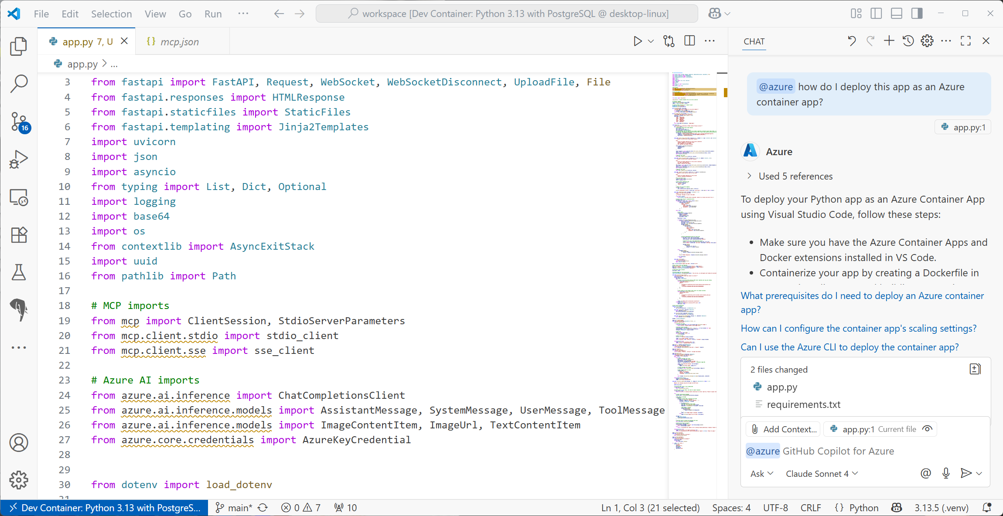
GitHub Copilot for Azure
Streamline your development workflow and enhance your productivity on the Azure platform
Notes:
Serena used GitHub Copilot for Azure to guide her through the deployment process. It’s not just generic advice—GitHub Copilot understands the project context and provides step-by-step instructions to prep it for Azure.
In Serena’s case, that meant configuring her app to run as an Azure Container App.
What’s powerful here is that she doesn’t need deep Azure expertise—just a clear goal and the right tools.
GitHub Copilot for Azure lowers the barrier to entry, so developers like Serena can ship with confidence, even if they’re new to cloud deployment.
And for Zava, this is where the investment pays off.
They now have a real, scalable agent experience—running securely on Azure, with the ability to manage, monitor, and evolve it over time. But this stage isn’t just about pushing code—it’s where Zava starts to realize the full value of the Azure ecosystem.

Slide 24























Streamline development with native IDE experiences
GitHub
Visual Studio
Visual Studio Code
Copilot Studio
Models
Agent Service
IQ
Tools
Machine Learning
Build context-aware and action-oriented agents with 1,400+ pre-built connections and MCP tools
Microsoft Bing
Microsoft Fabric
Microsoft OneLake
Control Plane
Leverage a complete signals management layer with Microsoft Security integrations
Microsoft Agent 365
Microsoft Defender
Microsoft Purview
Microsoft Entra
Security, compliance, and governance
Notes:
By deploying to Azure, Zava gains more than just compute—they get enterprise-grade infrastructure, security, governance, and lifecycle management tailored for generative AI workloads. Let’s unpack what that unlocks for Zava operationally and strategically.
First, Zava gains built-in security and compliance:
Role-based access controls
Managed identities and secret handling
Policy enforcement and enterprise-grade governance
Second, Zava gain access to a centralized model and agent management system:
Versioned deployments
Agent registries
Built-in evaluation pipelines
And finally, Zava benefits from scalable infrastructure that’s purpose-built for generative AI:
Elastic model serving (i.e. ability to automatically scale AI model inference infrastructure up or down based on demand—so your application remains responsive without over-provisioning resources.)
And visibility into cost and usage metrics
This is what Microsoft Foundry unlocks for Zava: A production-ready, secure platform that supports not just the launch—but the lifecycle of their AI-powered customer experience.
And of course, once Cora is live—Zava needs to keep everything healthy, trustworthy, and measurable.
That’s where observability comes in.

Slide 25
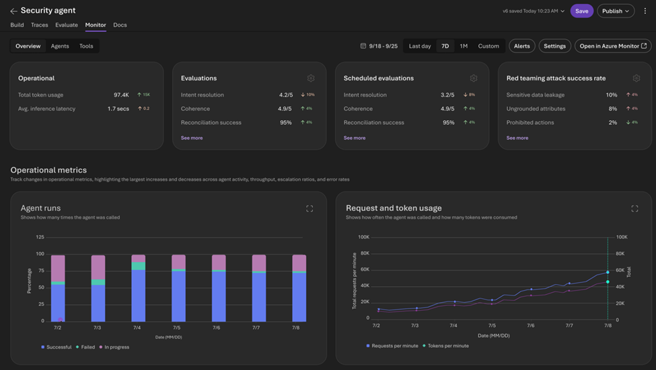
Foundry Control Plane
Foundry Control Plane, integrated with Azure Monitor Application Insights, enables you to continuously monitor your AI applications
Notes:
Once Cora is live, Serena and the Zava team need more than just logs—they need real visibility into how the system is performing.
That’s where observability becomes critical.
For example—let’s say Bruno, our painting customer, messages Cora and gets no product recommendation in return.
Is it a model issue? A backend error? Did the MCP tool call fail?
With Foundry Control plane, Serena can trace the entire flow end-to-end—from the initial user message, to the agent’s tool call, and to the agent’s response. The Microsoft Foundry Control Plane is a unified management interface that provides visibility, governance, and control for AI agents, models, and tools across your Foundry enterprise.
She can drill into:
Latency across steps
Failures in tool calls or model responses
And even see custom metrics she’s defined, like evaluators to assess agent friendliness
This level of observability means Zava can detect problems faster, resolve issues proactively, and ultimately deliver a more reliable customer experience.

Slide 26
From idea to impact
In this session, you saw how to:
1
Rapidly prototype with Microsoft Foundry models using the AI Toolkit
Design and evaluate agents in VS Code using Agent Builder
2
What Serena built in VS Code… now powers Zava’s production app.
Use GitHub Copilot Agent Mode for model selection, evaluation, and tracing
3
Deploy to Microsoft Foundry for scale, security, and observability
4
Notes:
Today we walked through what it really looks like to go from idea to impact—from building your first agent to deploying a production-ready AI agent solution backed by Microsoft Foundry.
You saw how tools like the AI Toolkit, GitHub Copilot, and Microsoft Foundry fit together into a developer-first GenAI workflow.
And you saw how Serena—working under pressure, with limited bandwidth—was still able to ship something powerful, scalable, and responsible.

Slide 27
Thank you

Slide 28

Join the AI Conversation on Discord
gaic.io/discord

